Slide 1
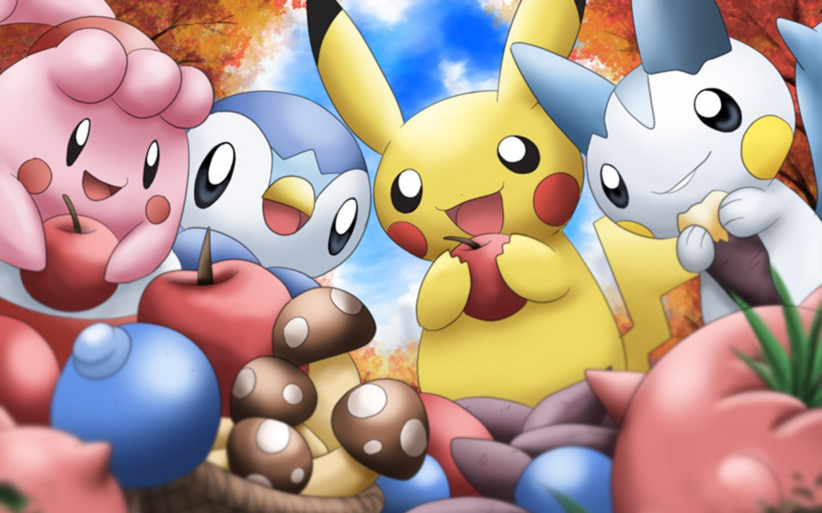





Tabetai食べたい Inc
By: Vikram Miryala, Richard Ma, and Keontrye Hsieh

Slide 2

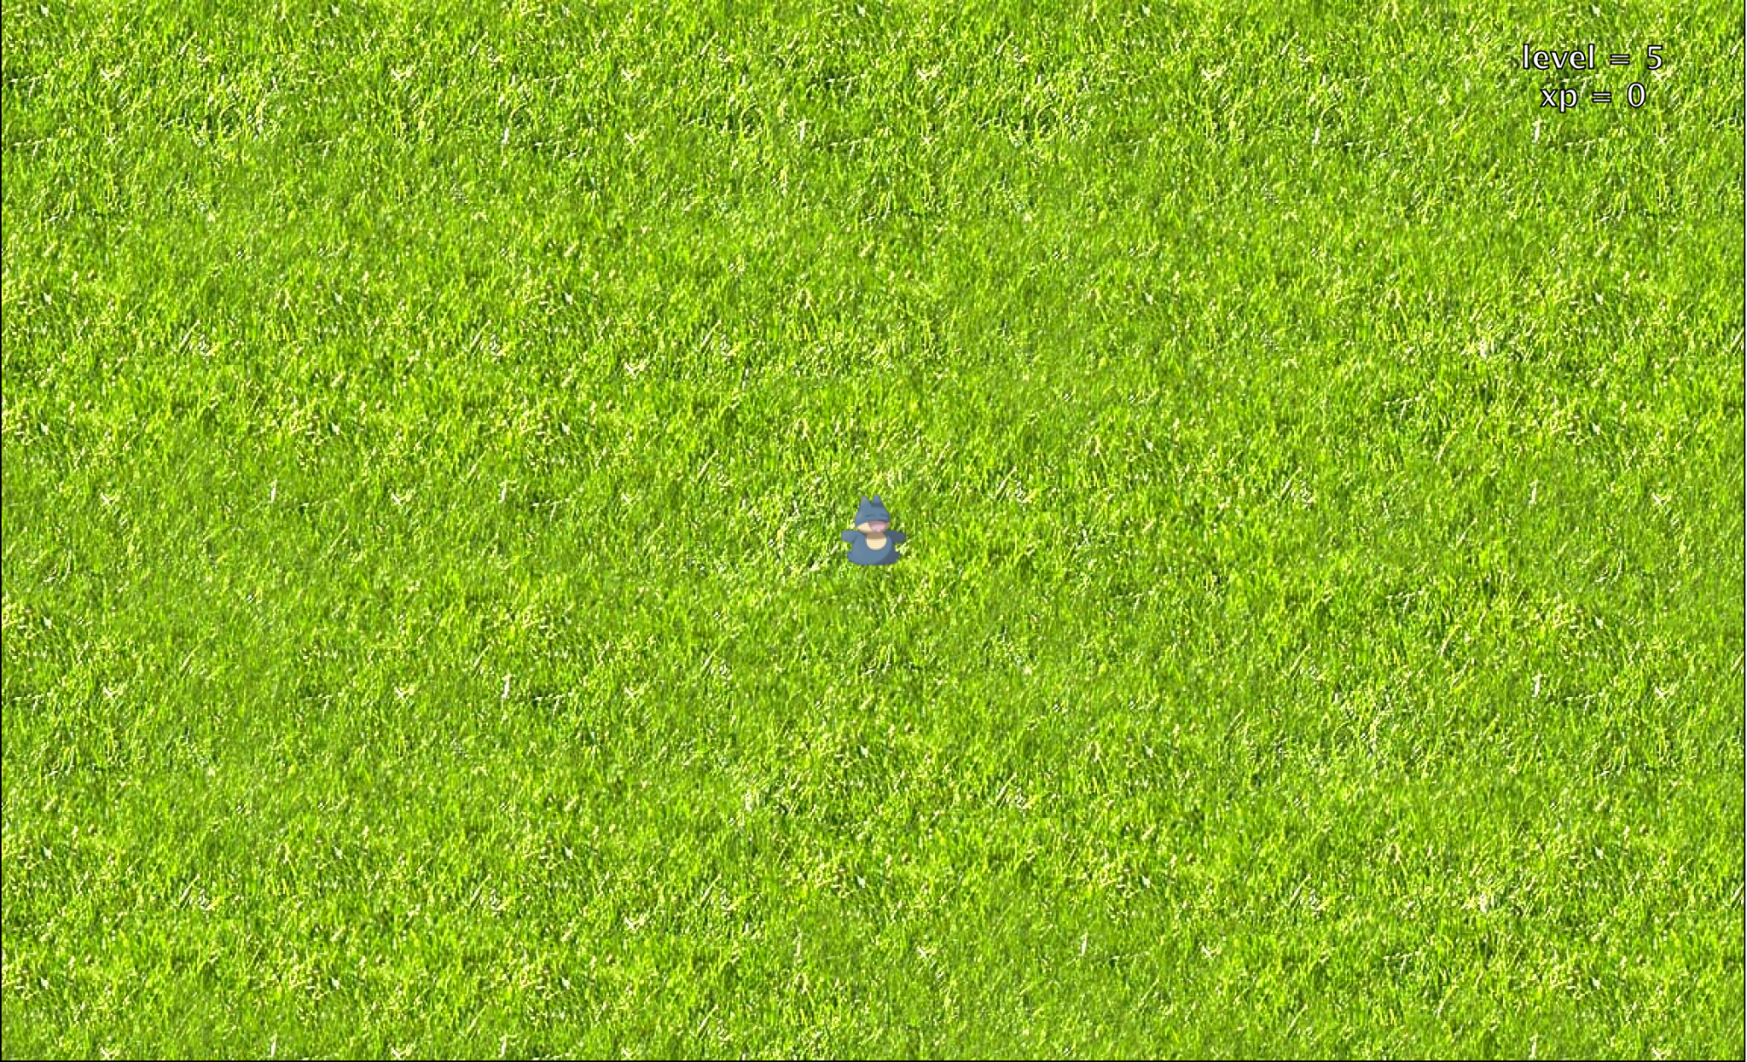
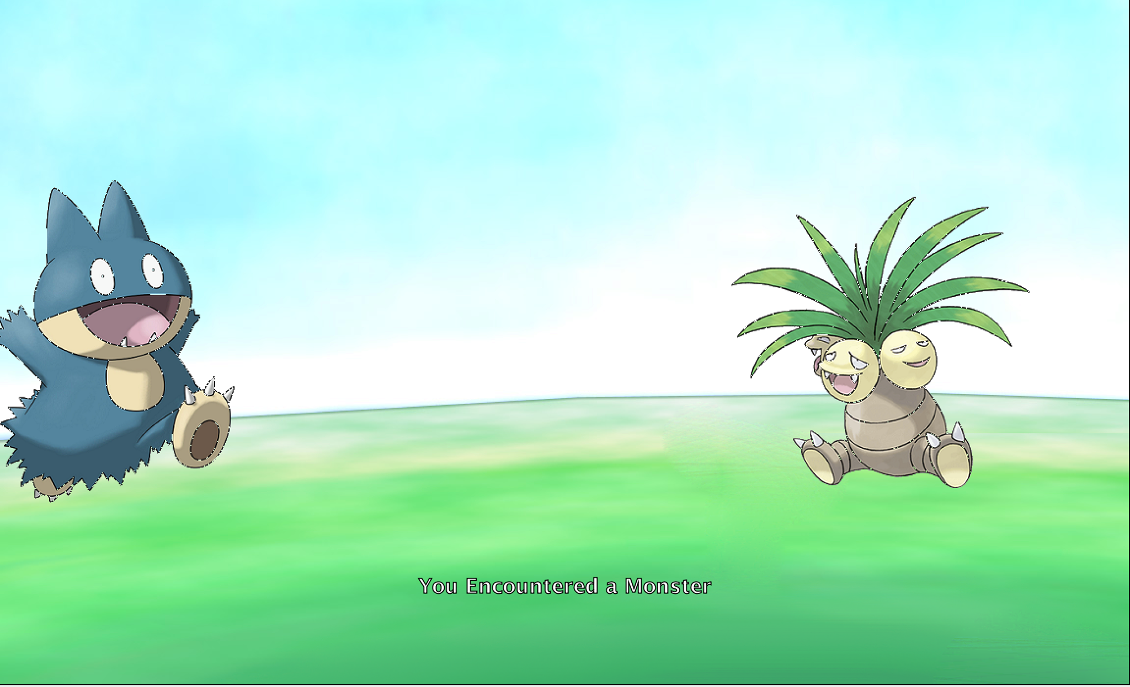
GUI (Graphical User Interface)

Slide 3
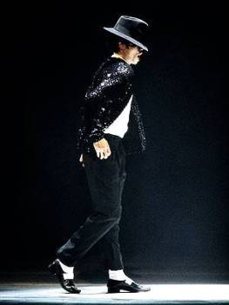

Characters:
He can move left
He can move right!
He can move up!!
He can move down!!!
But he can’t...
Munchlax (Player)
TURN AROUND! XC

Slide 4
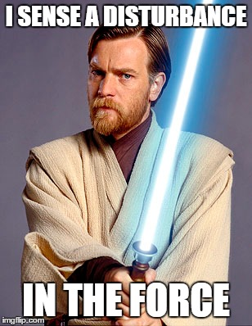
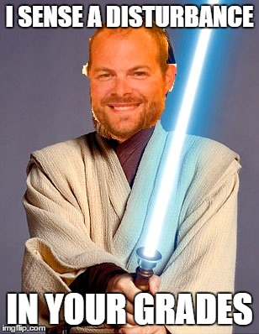
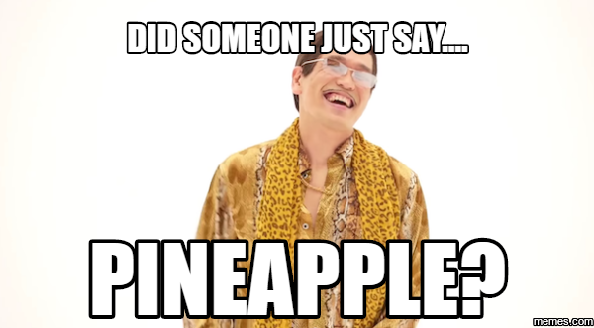
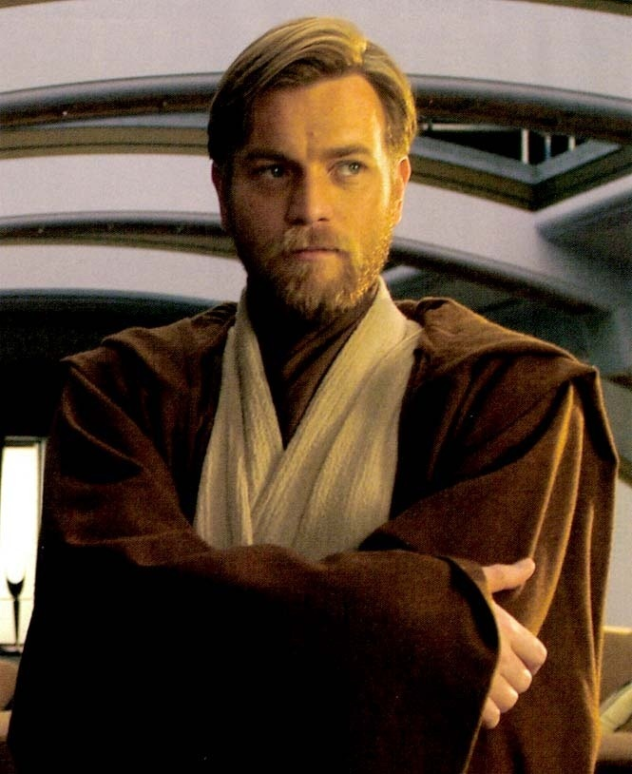

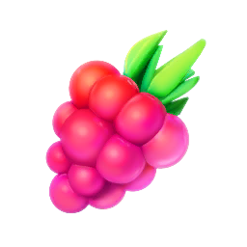
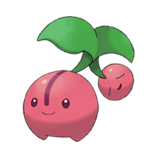
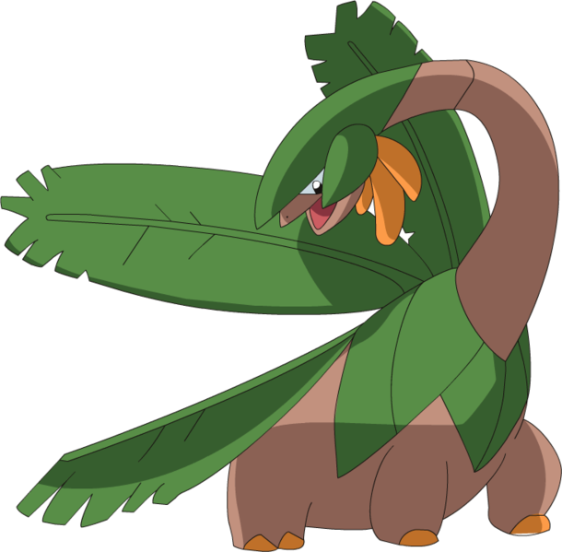

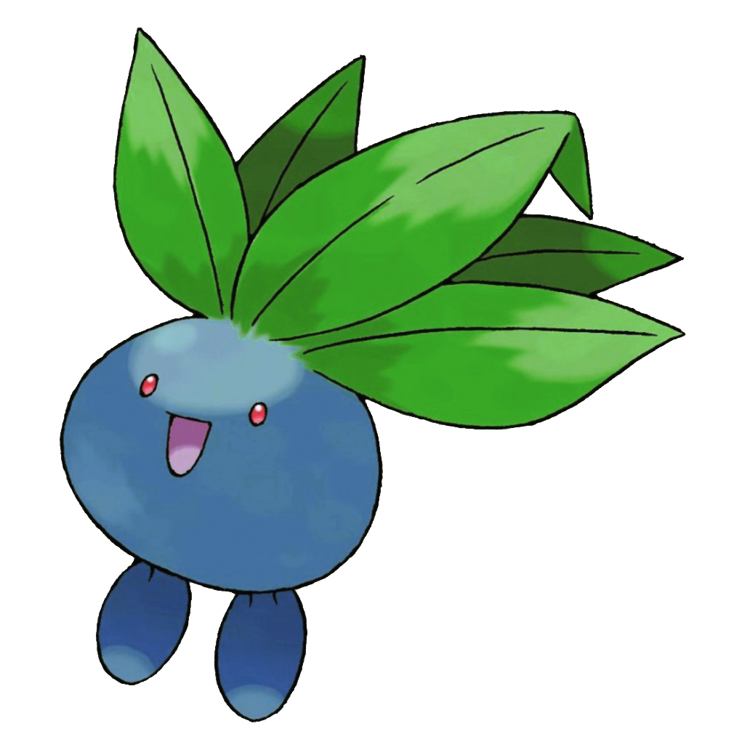

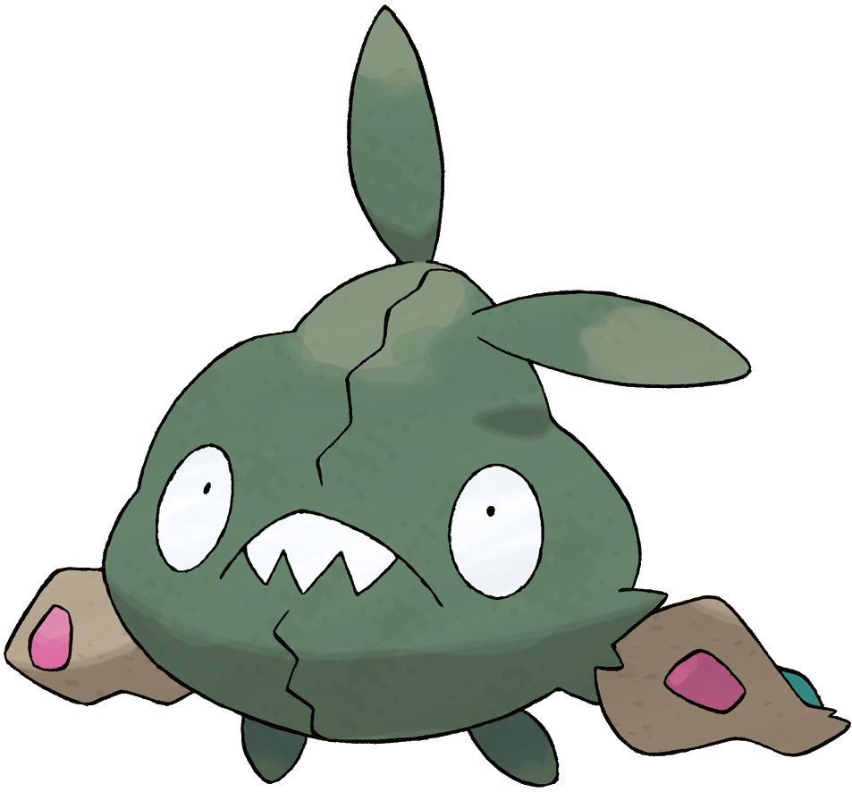
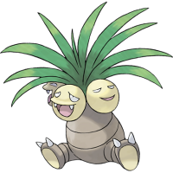
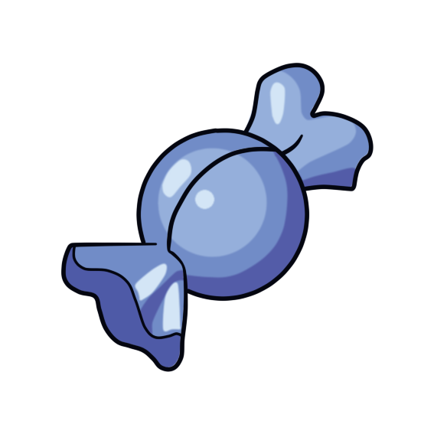
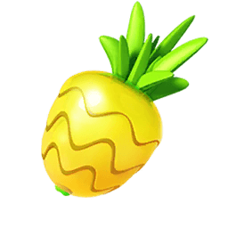
Game Objectives:
Collect berries to gain exp
Berries can be disguised as monsters that also give exp

Slide 5
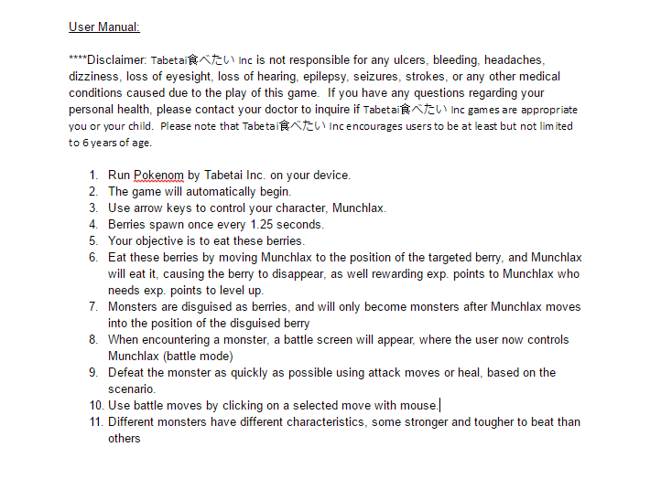
User Manual
View the full user manual here:
https://docs.google.com/document/d/1gAKktCJvU-Xkc5ZRxJDLmGFESuz-jsDRKsDdWhvaFmU/edit?usp=sharing

Slide 6
Object Oriented Design (OOD)
Position.java
World.java
Character.java
Background.java
Actor.java
Battle.java
Moves.java
Berry.java
Monster.java
Munchlax.java
Tackle.java | Rest.java | SolarBeam.java | Metronome.java
Cherubi.java | Oddish.java | Exeggutor.java | Tropicus.java | Trubbish.java
RazzBerry.java | OranBerry.java | PinapBerry.java | NabNab.java | RareCandy.java

Slide 7
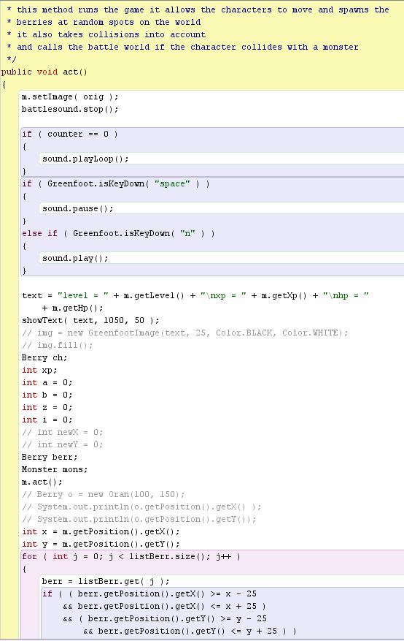
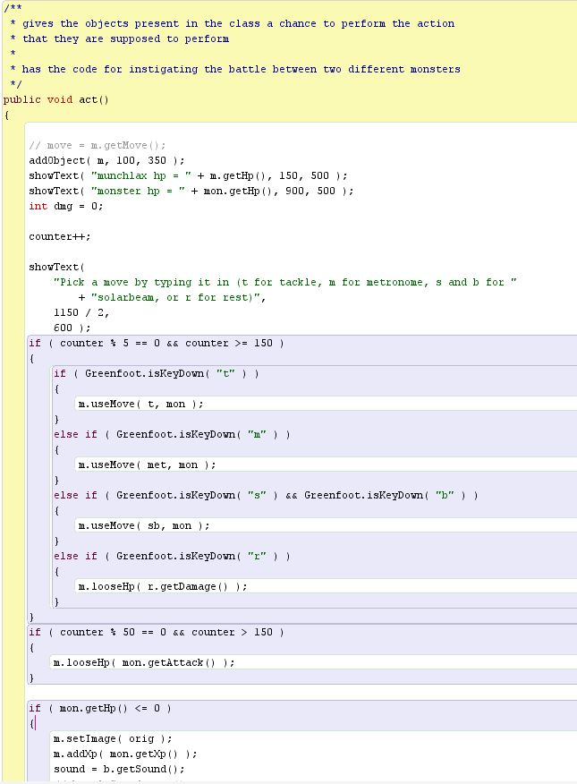
Coding- Greenfoot

Slide 8
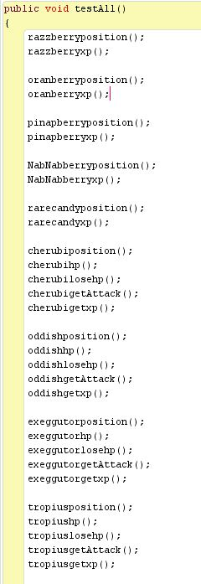
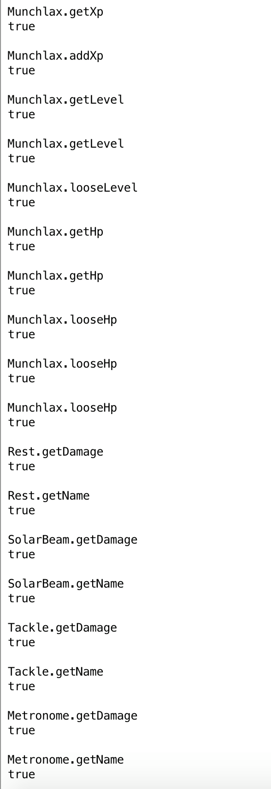
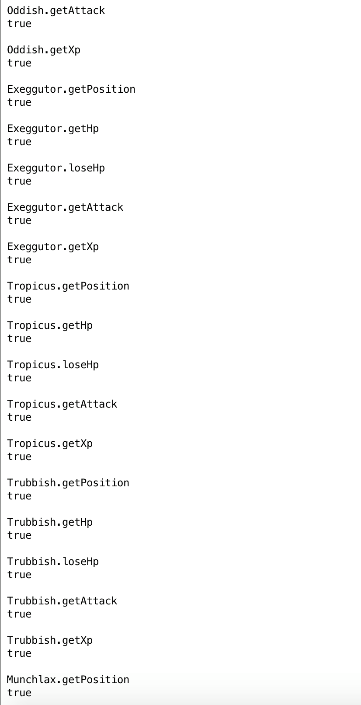
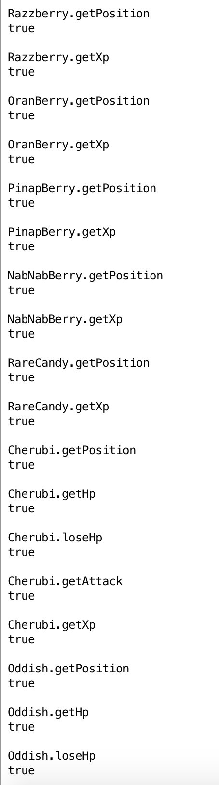
Coding - Testing
Junit testing
Beta Testing

Slide 9

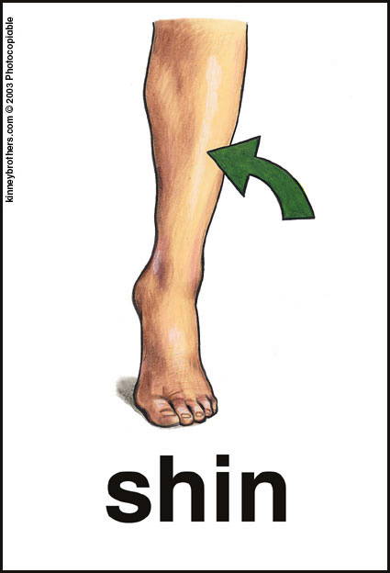

Demonstration
Demon
Straight

